Slide 1
Marketing Project
Car Evaluation Database
NIRALI KHIRSARIA

Slide 2
Project Proposal
The aim of this project is to conduct a comprehensive market analysis of the provided dataset containing used vehicle information.
This analysis aims to provide valuable insights into various aspects of the market, including price trends, popular vehicle types, brand preferences and the impact of other factors.
OBJECTIVE:
Perform segmentation analysis based on vehicle type, brand, fuel type, year of registration and other relevant factors.
Analyze price trends and identify factors affecting used car prices.

Slide 3
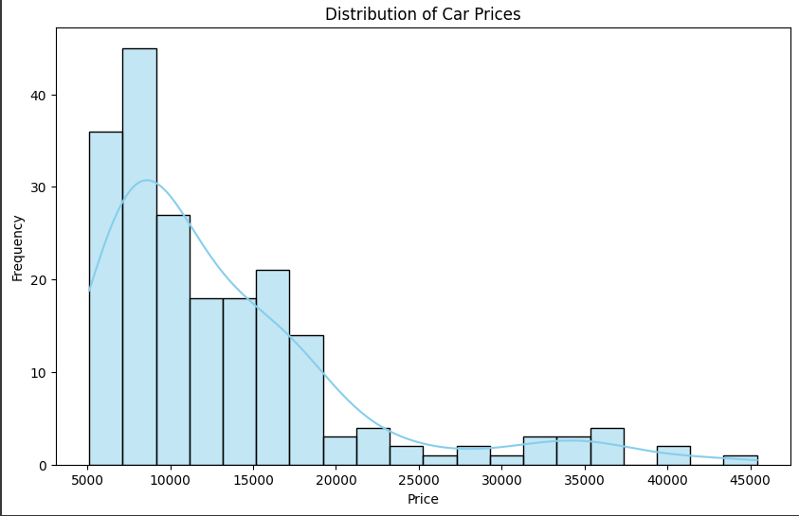
Histogram for Price.
Observation: Positive skewed
Distribution of price is right skewed and it helps us to find which price range customer generally bought cars.
there are relatively few high-priced items compared to the number of lower-priced items.
there is a concentration of prices on the lower end, with a few high-priced outliers.
In a market context, a positively skewed price distribution might suggest that most products or services are priced relatively low, but there are some premium or luxury items that command significantly higher prices.

Slide 4
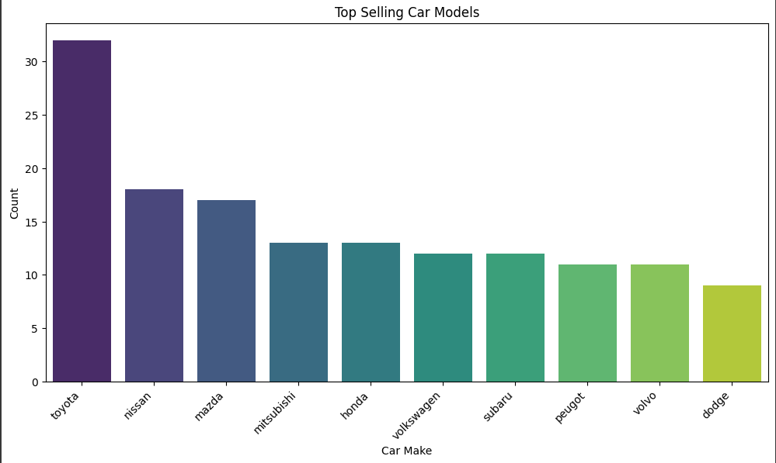
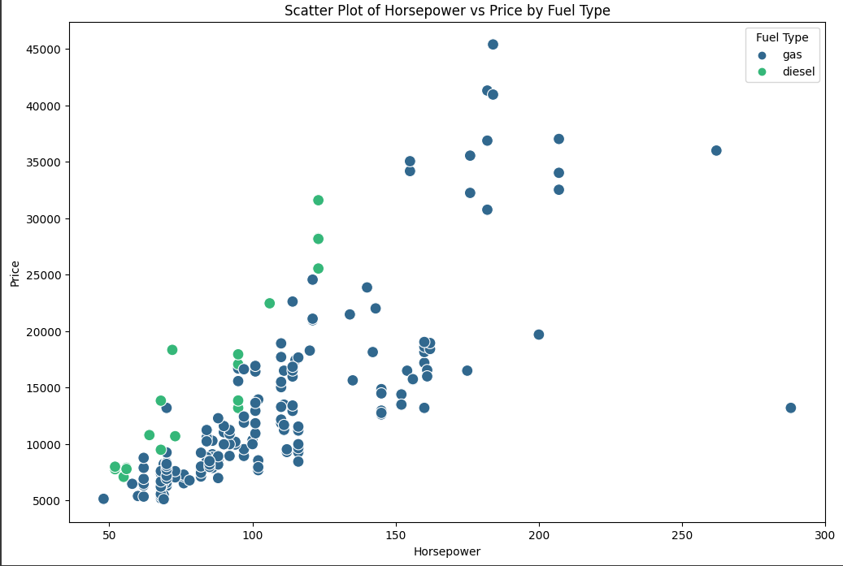
Basic charts to observe customer behavior:

Slide 5
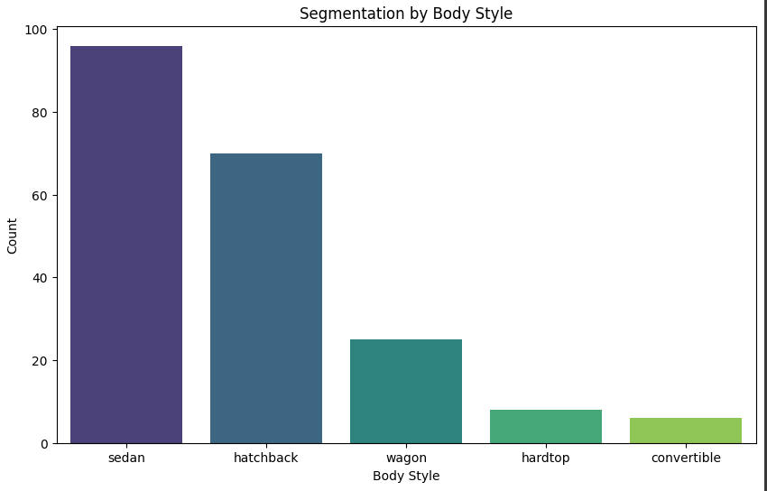
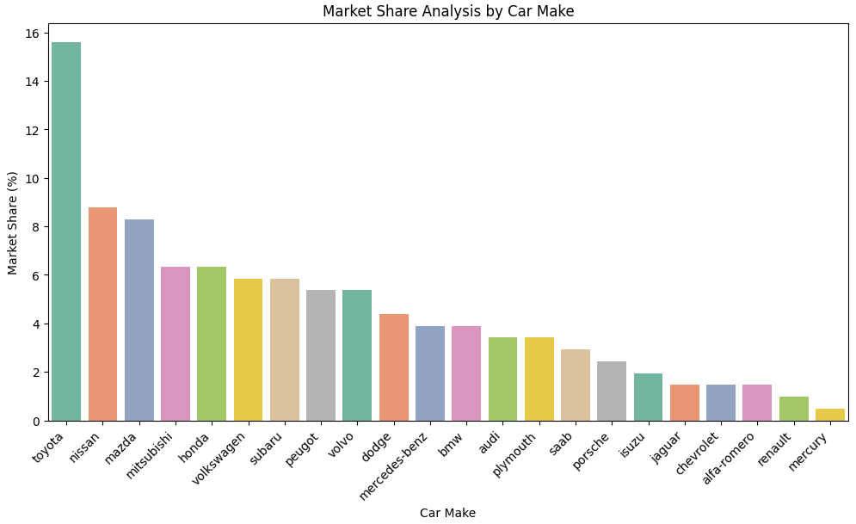
Market analysis:

Slide 6
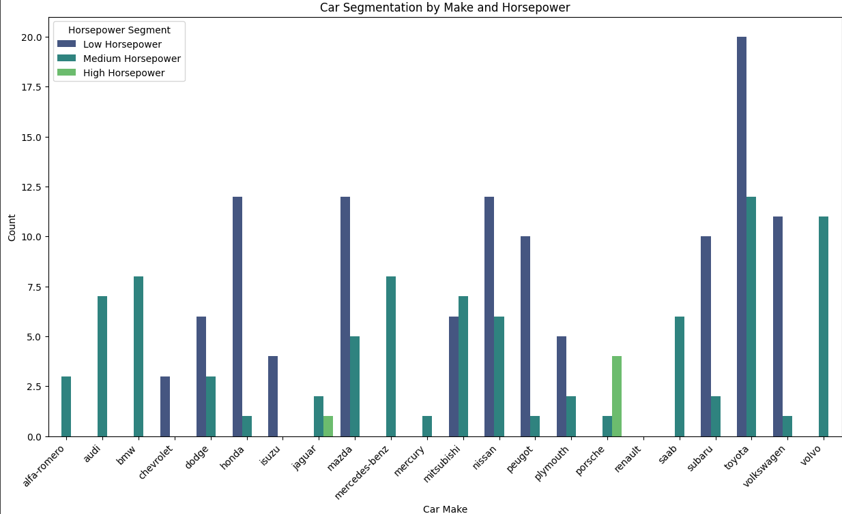
Segmentation analysis:
Segmentation analysis involves dividing a market into distinct groups based on certain criteria to better understand and target specific customer needs and preferences.
Here we can observe that customer mostly prefer lower horsepower cars tend to be more fuel-efficient. Toyota have highest selling count. Cost of this cars are highly comparable.
High horsepower cars like Porshe, Jaguar are luxury cars. In market these kind of buyers are less.
After doing segmentation analysis we can find usage pattern , brand , preference of customer and this analysis help us to identify future selling count , marketing plan.

Slide 7
Conclusion and Recommendation:
Help of segmentation analysis, Understanding these segments can help tailor marketing strategies more effectively.
From this project, We can actually understand which type of cars customer wants to buys.
We can identify customer behavior and what type of specification in cars they actually need.
Evaluate the performance of different car making company have what percentage of market share that stand out and consider leveraging these in marketing campaigns.
Recommendation:
Enhance Product Features: Identify areas where product features can be enhanced or introduced to align with consumer preferences
Collaborate with Dealerships: Work closely with dealerships to align marketing strategies with on-the-ground sales efforts.
Leverage Popular Models: Highlight and promote models that exhibit high performance, fuel efficiency, or other appealing features.

Slide 8
THANK YOU

